Slide 1
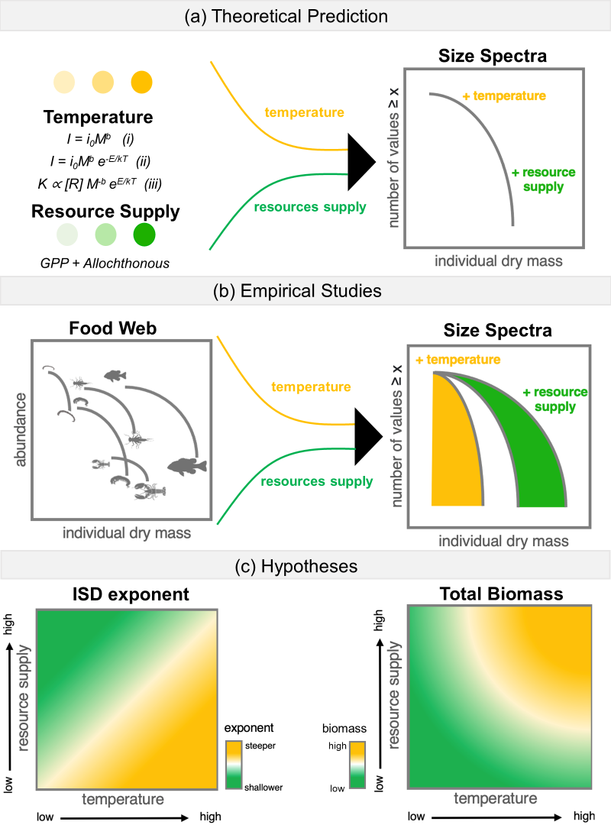

Slide 2

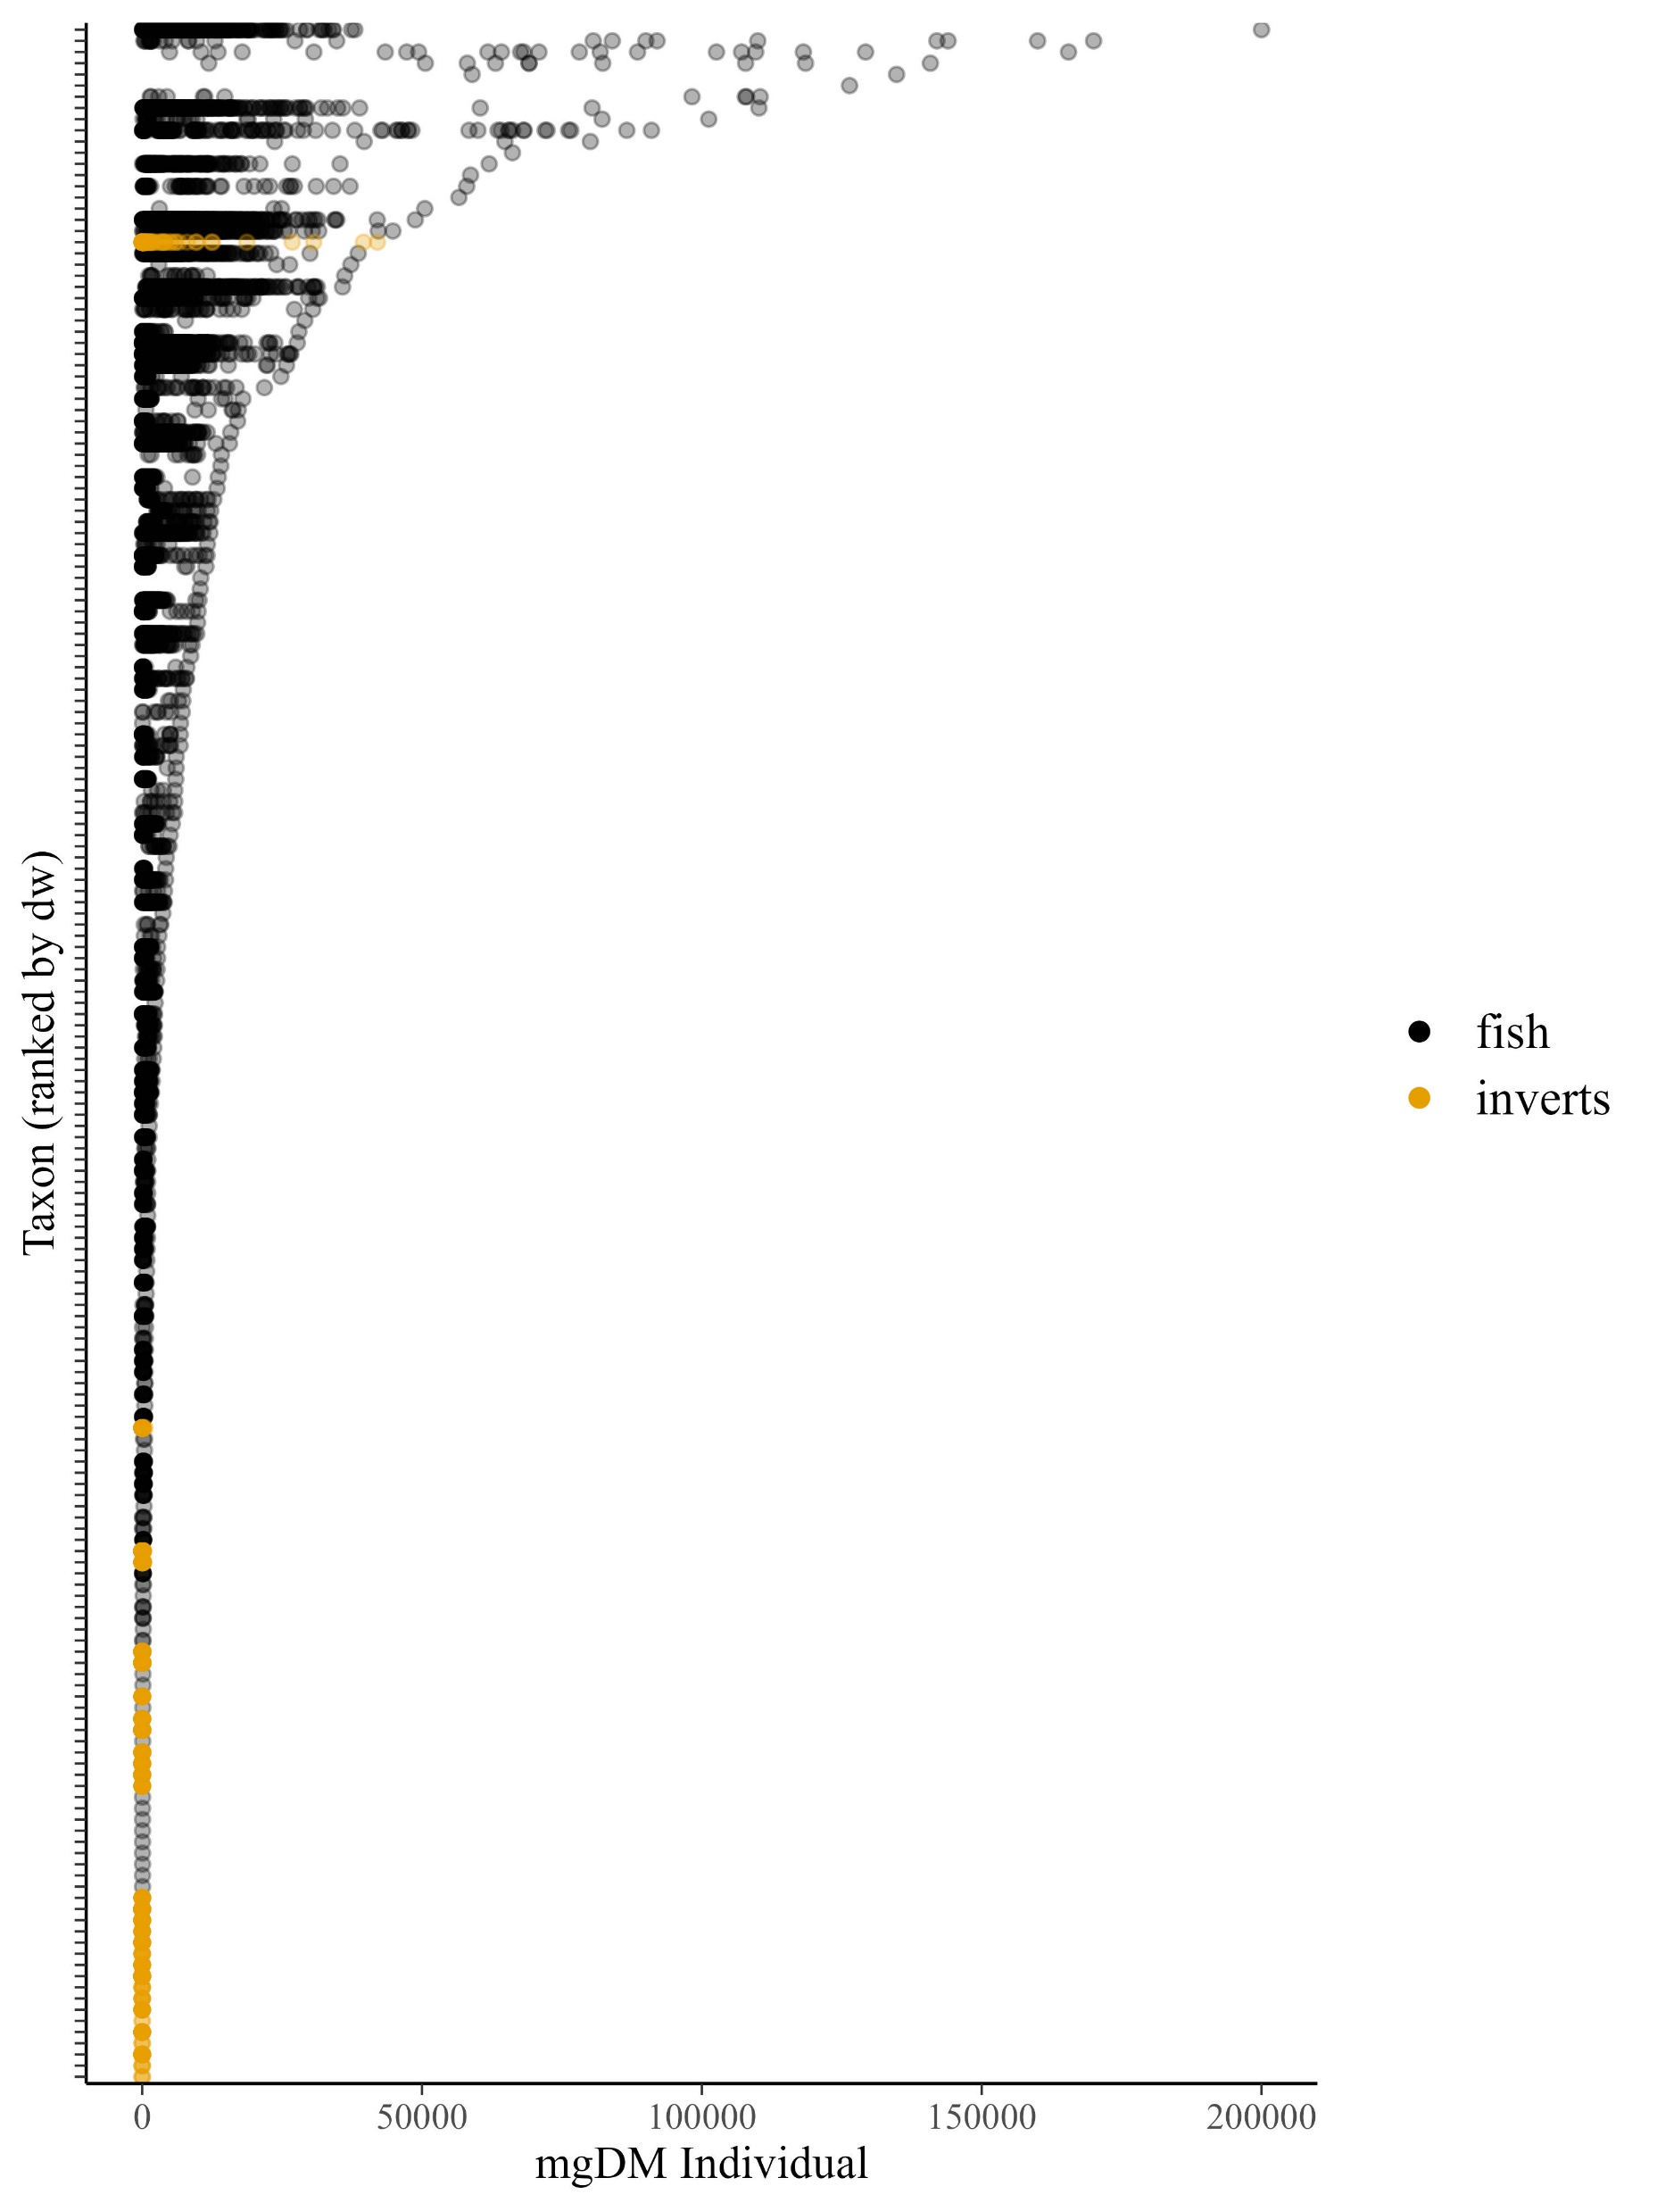







Slide 3
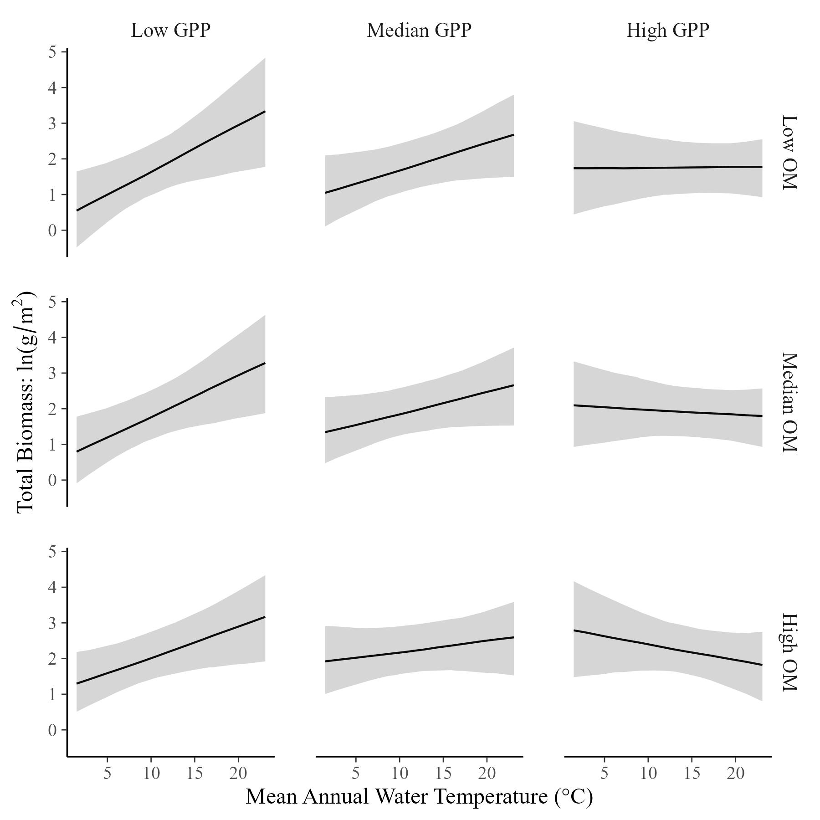
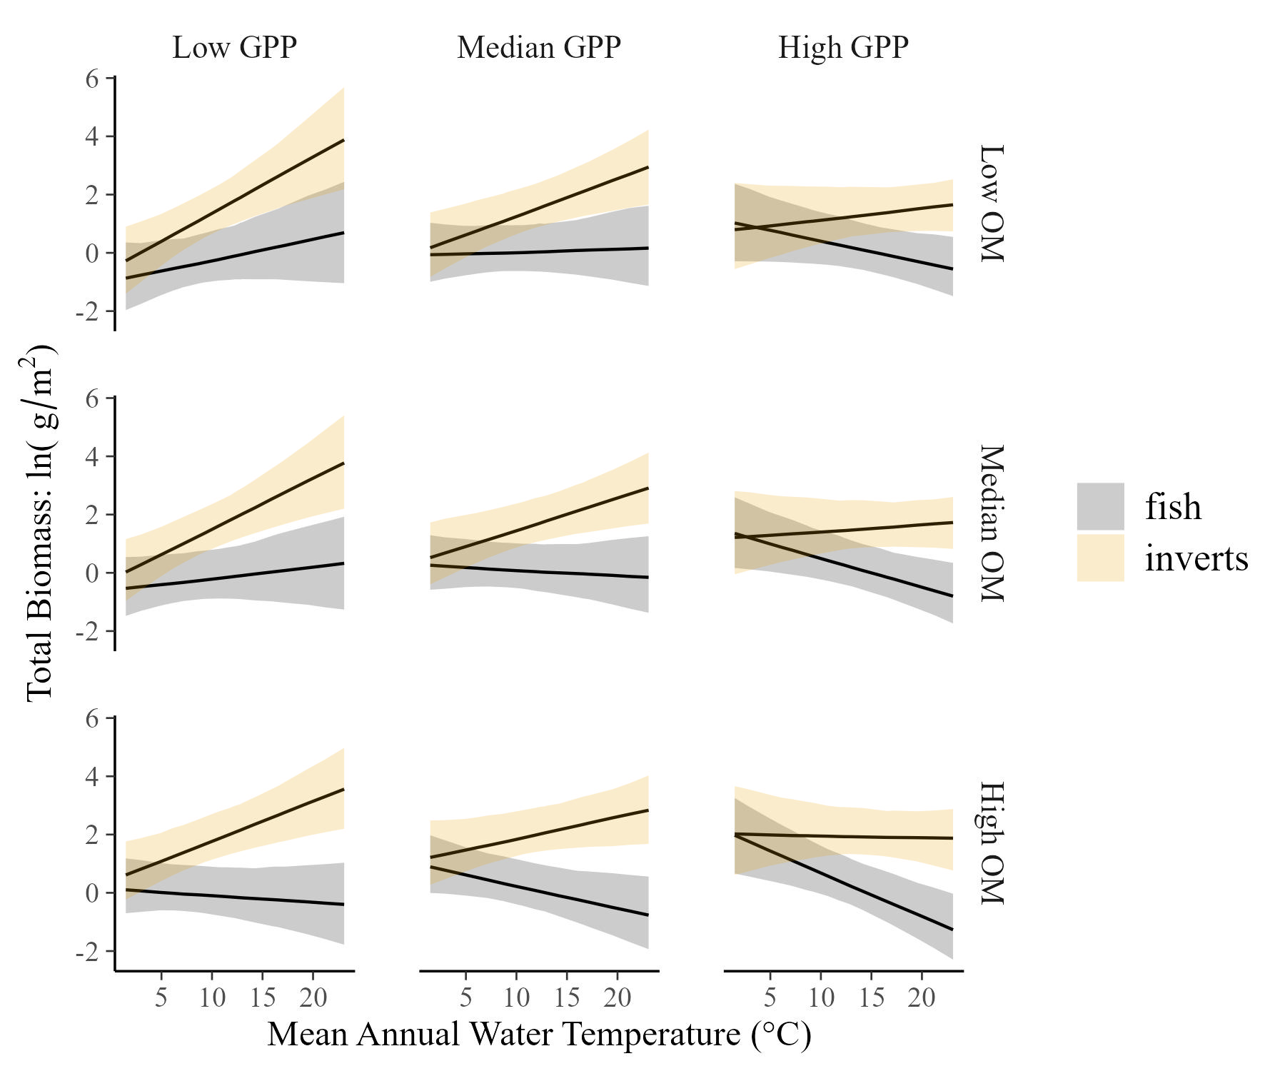
Total Community Biomass varies with temperature and resources…
…and it appears to be a compromise between fish and invertebrates

Slide 4
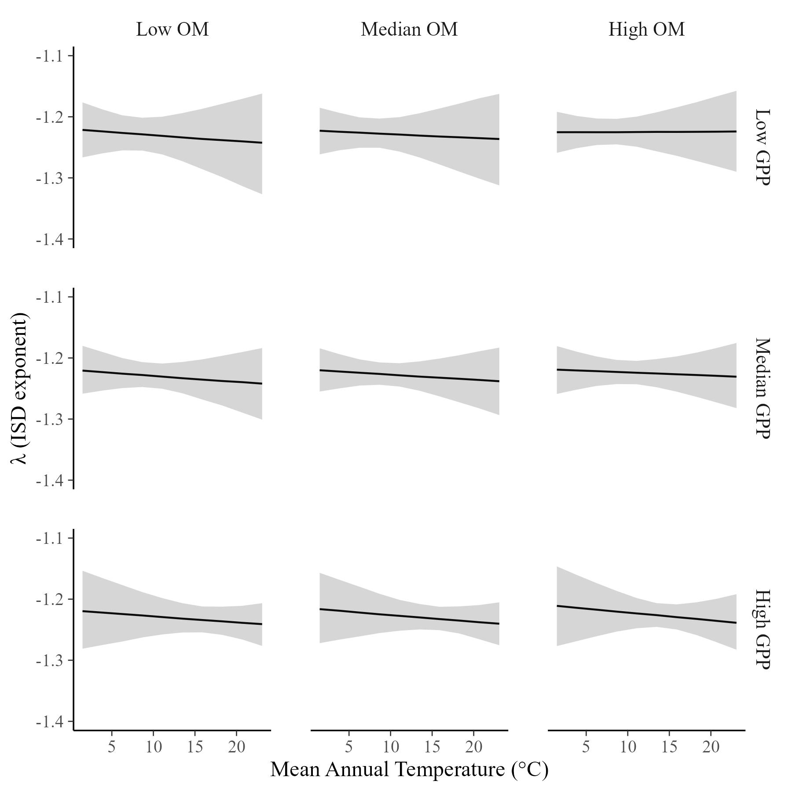
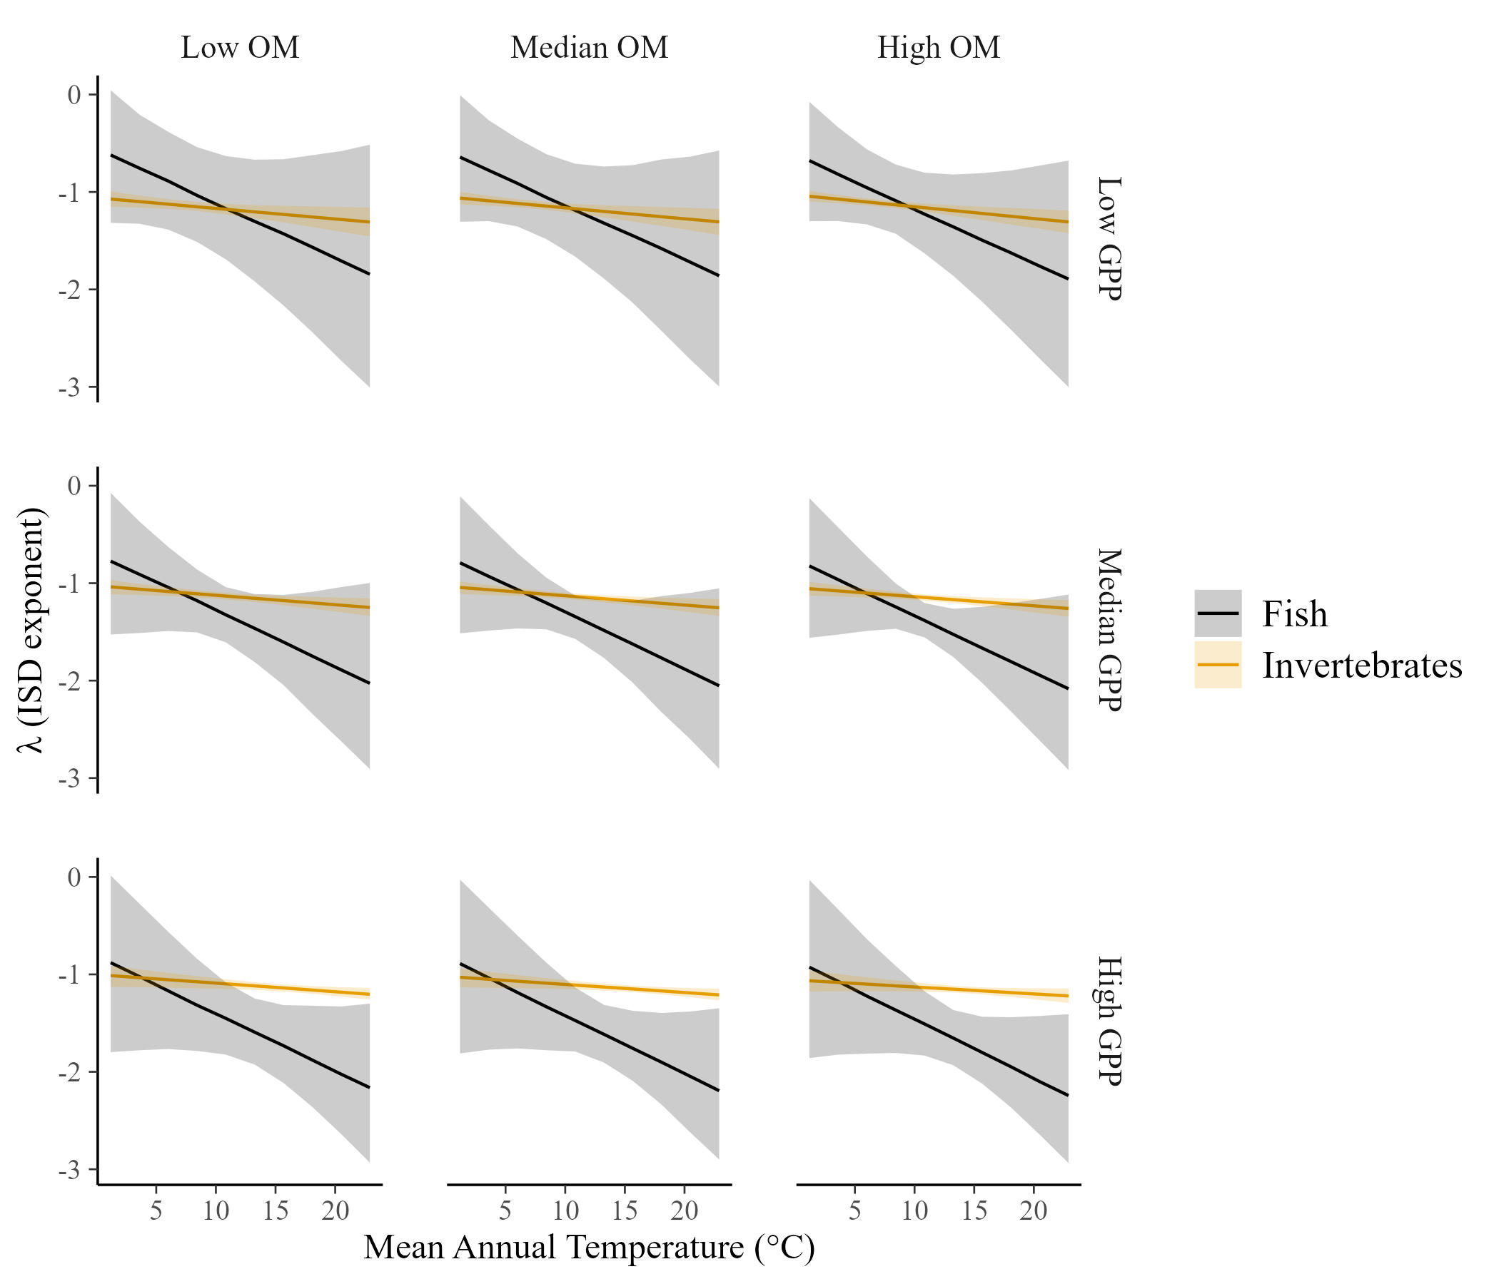
The ISD is constant across temperature and resource supply
…but it varies across temperature for fish and macroinvertebrates

Slide 5
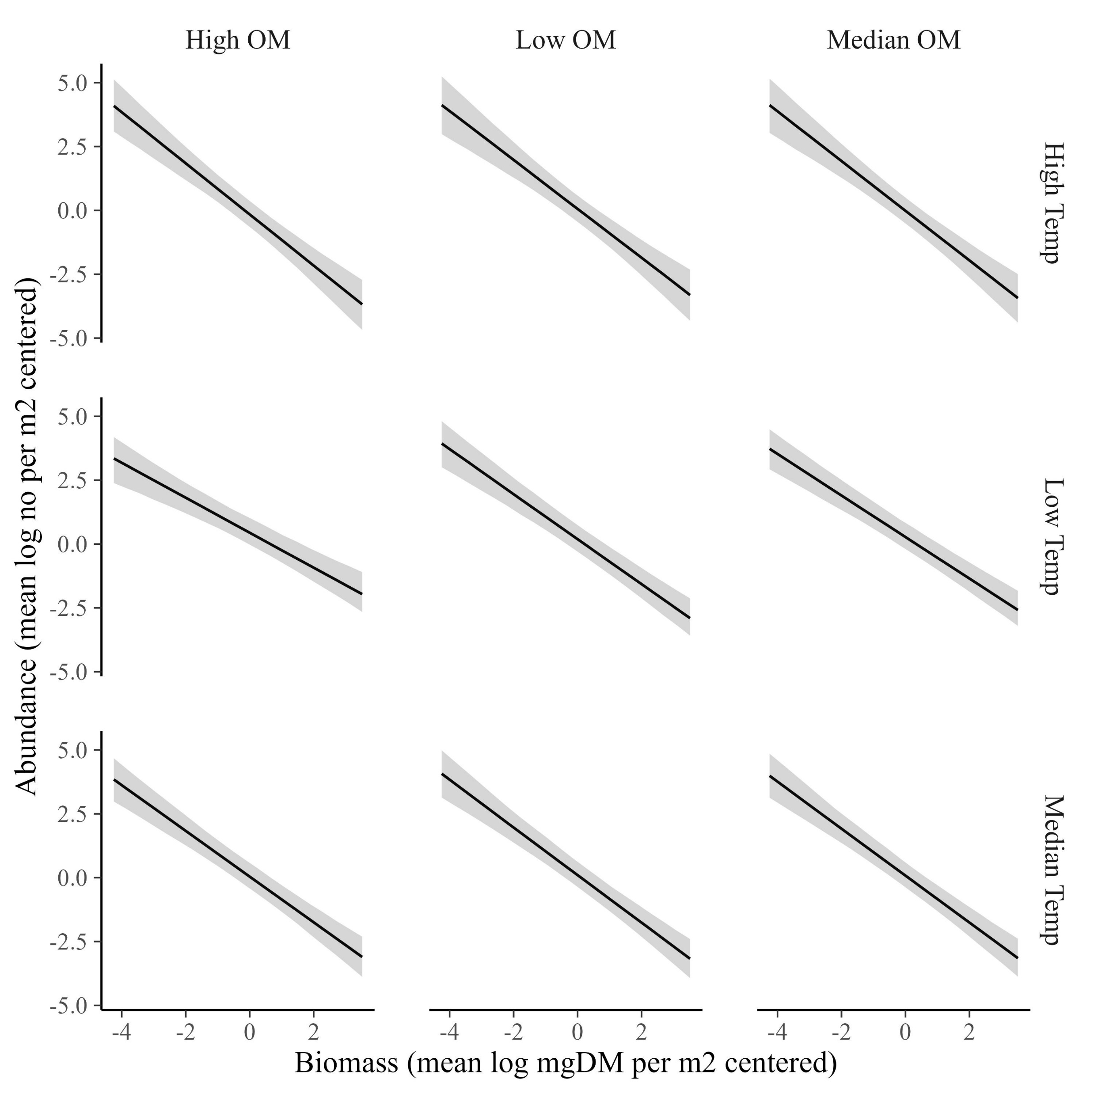
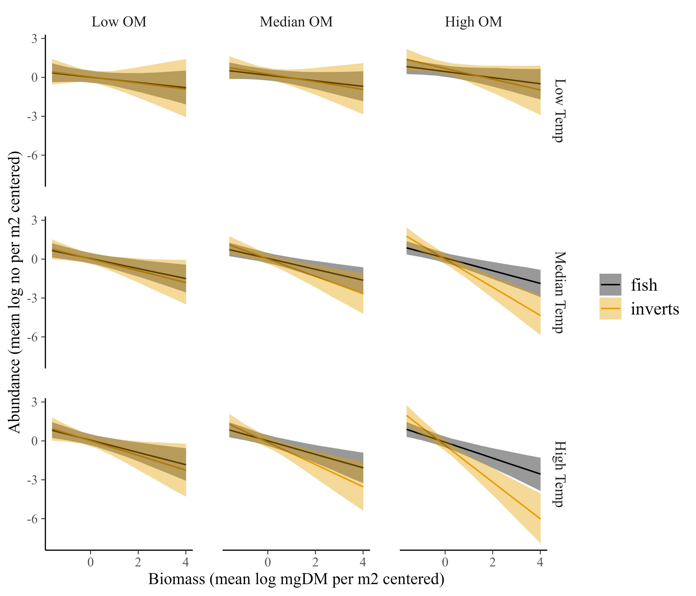
The CCSR varies somewhat with temperature and resources, ranging from about -0.7 to -1…
…but that variation is minimal compared to the changes for fish or invertebrates separately.

Slide 6
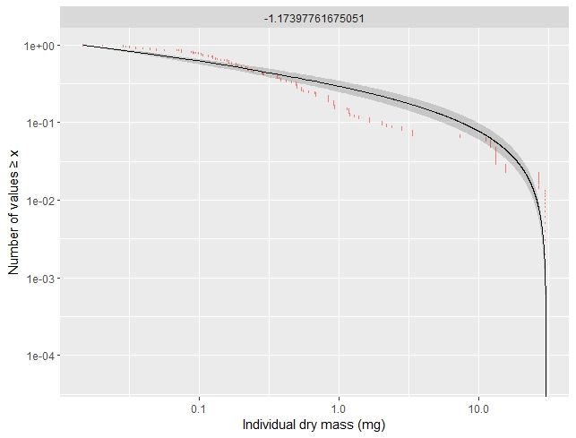
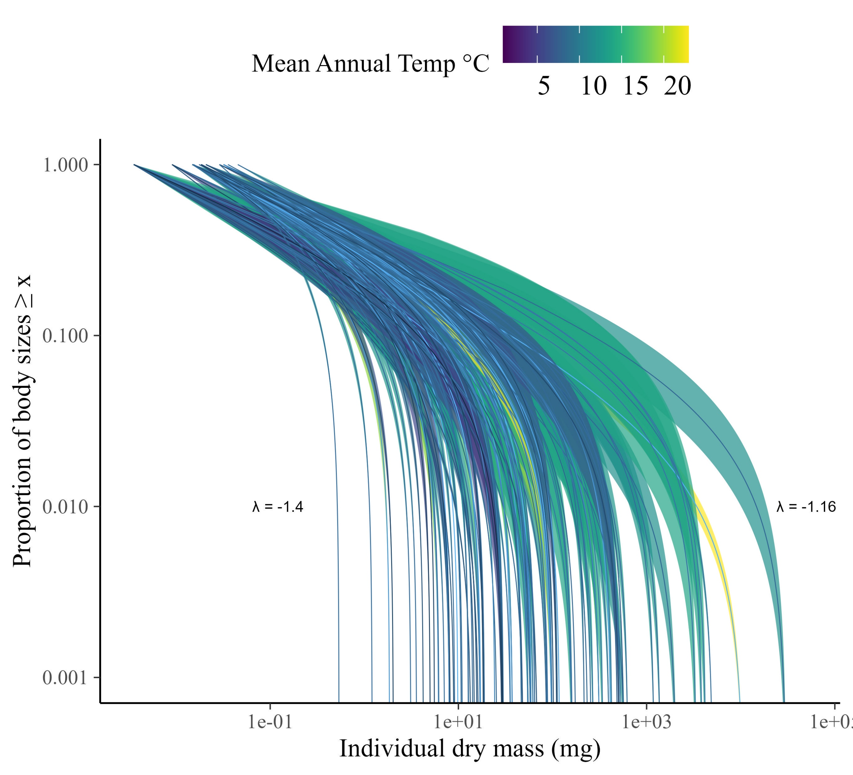
ISD’s vary among samples (posteriors shown).

Slide 7
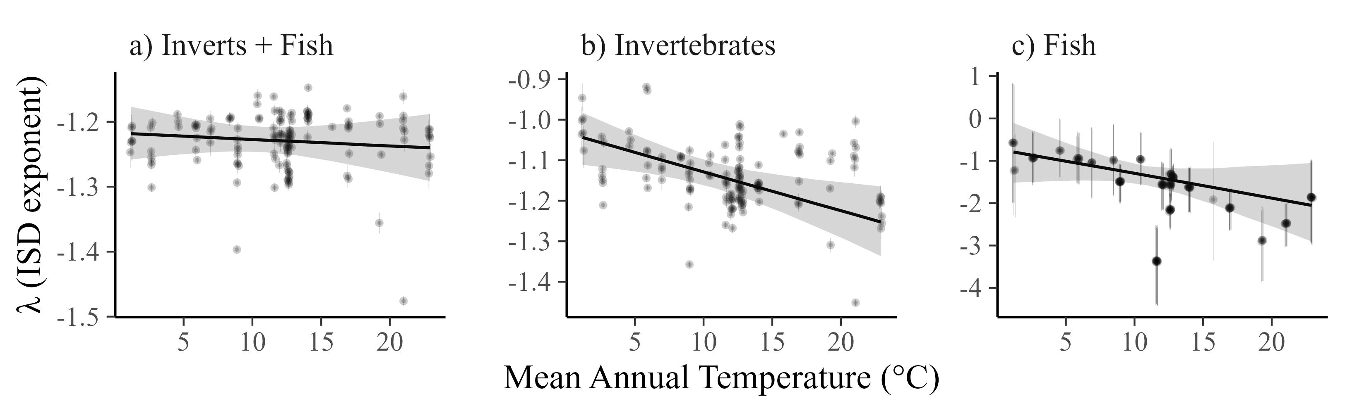
But ISD does not vary with temperature
*Note the change in y-axis scales across panels.

Slide 8
ISD consistency is independent of OM and GPP (i.e., no interactions)

Slide 9
However, for individual taxa (inverts and fish), the ISD declines with temperature, particularly for fish.
*Note the change in y-axis scales across panels.

Slide 10
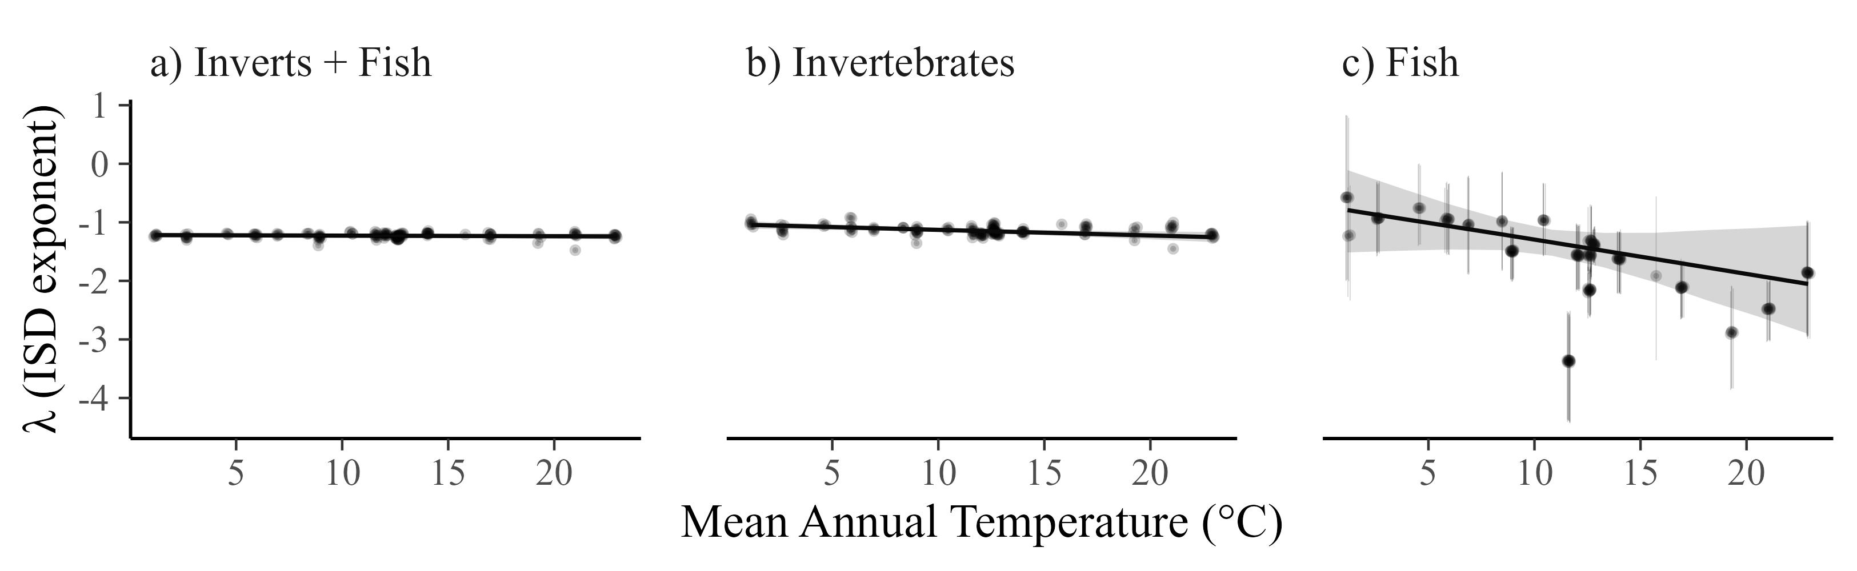
Same plot but with a common scale. Fish are odd.

Slide 11
For fish and inverts, the ISD relationship with temperature does not interact with resource supply

Slide 12
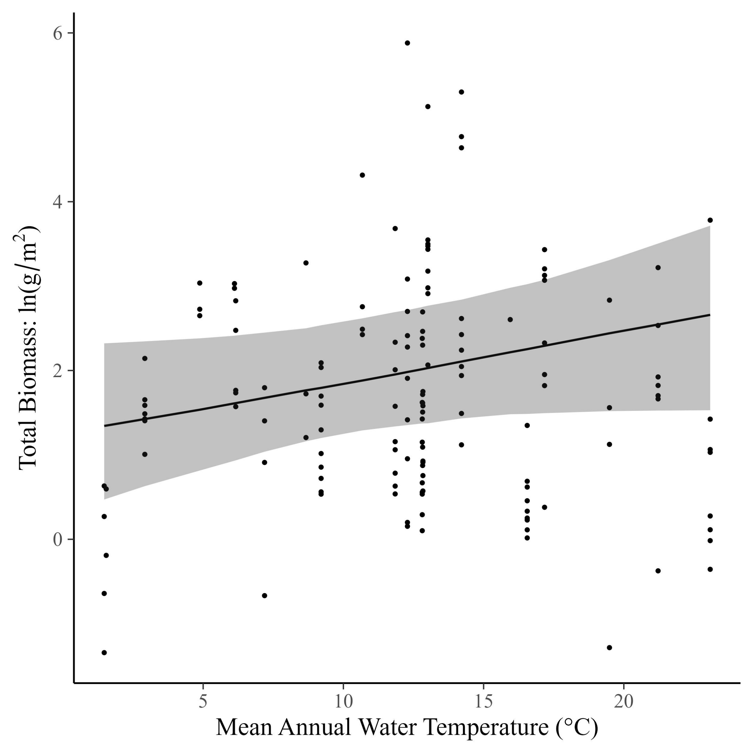
Total community mass weakly increases with temperature (0.04 [95% CI: -0.22, 0.3])

Slide 13
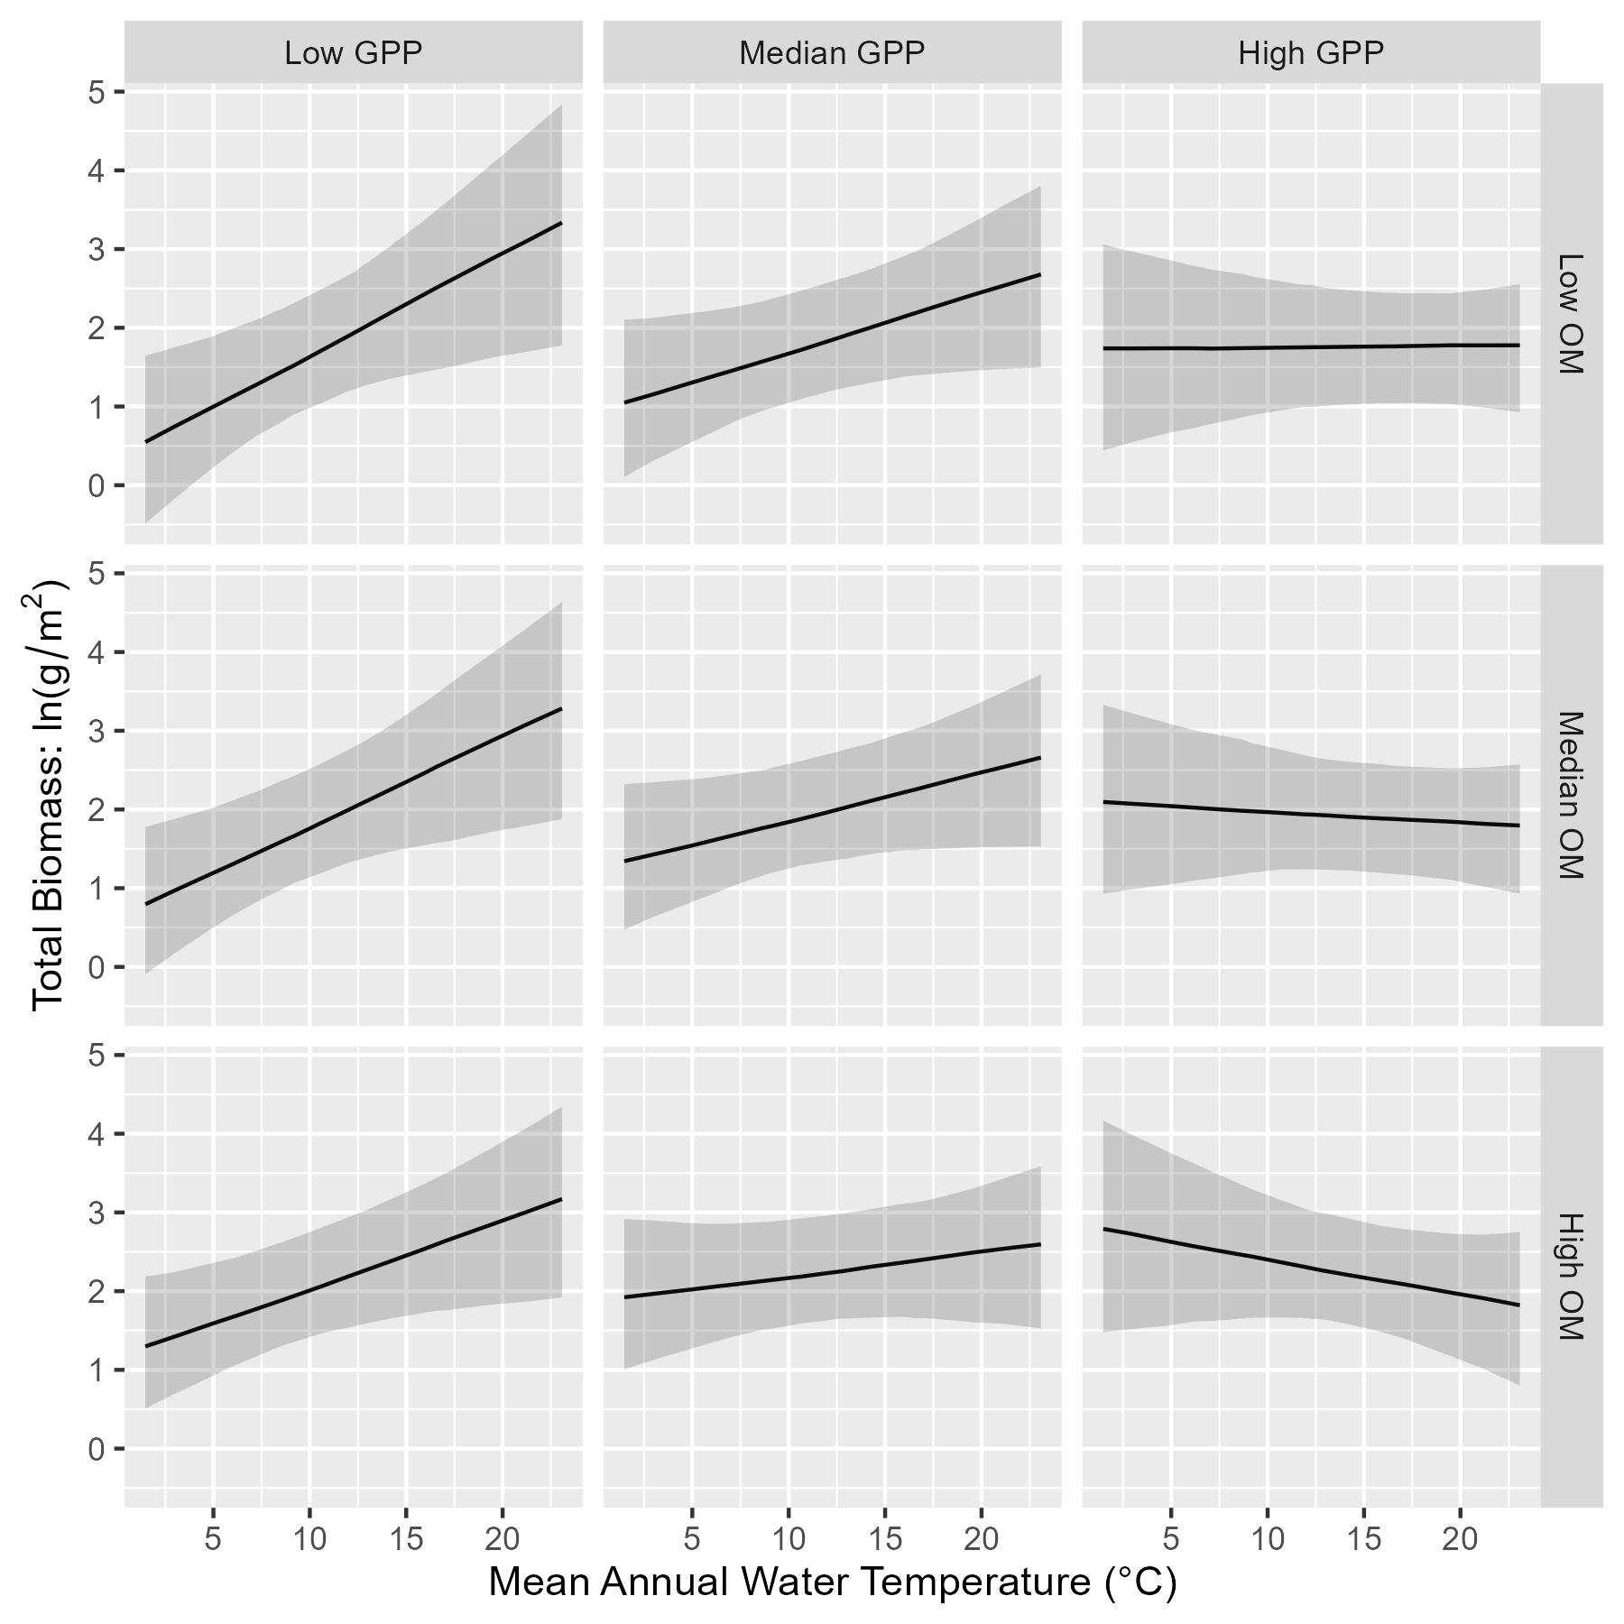
But…relationship of total biomass with temperature depends on resources. It is positive at low GPP and low OM, but becomes negative at high GPP and high OM.

Slide 14
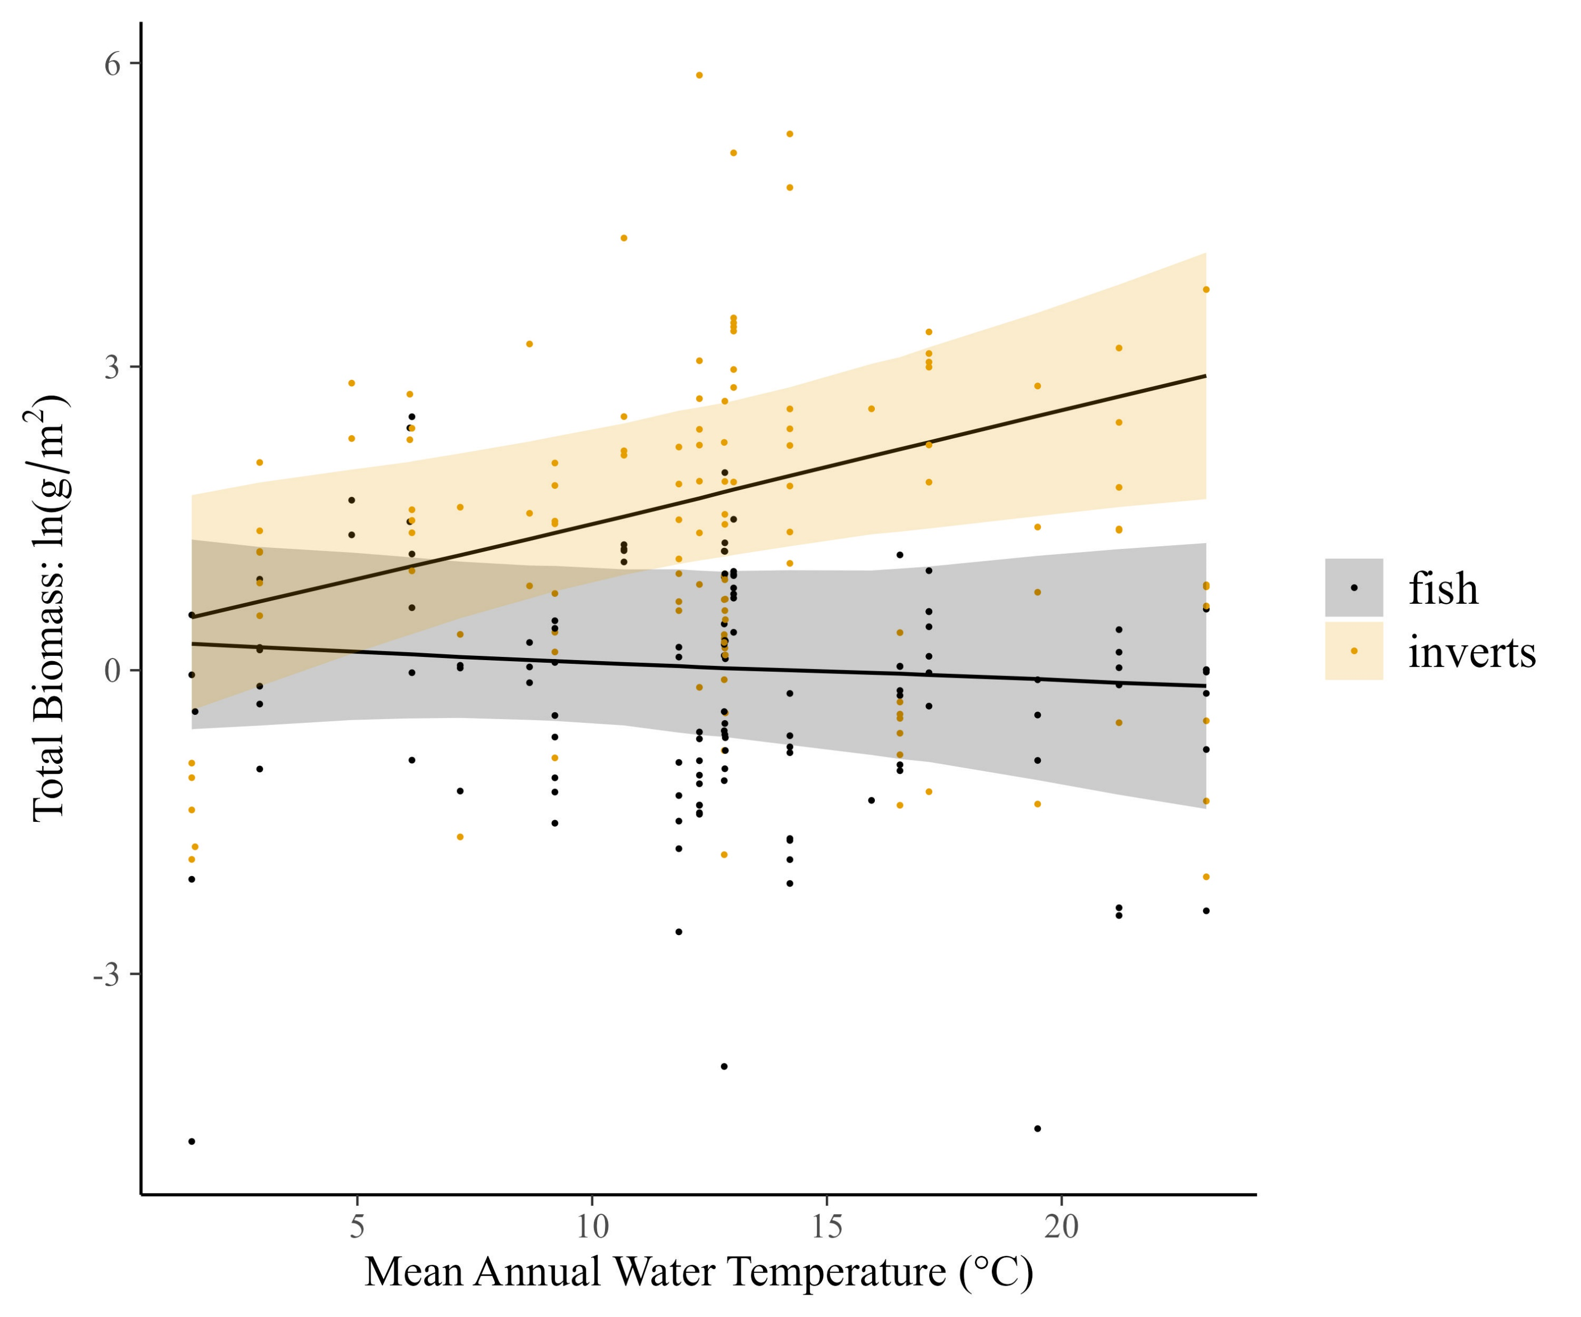
Temperature dependence of total biomass also differs for fish and inverts

Slide 15
Temperature dependence of total biomass also differs for fish and inverts…with interactions of resource supply

Slide 16
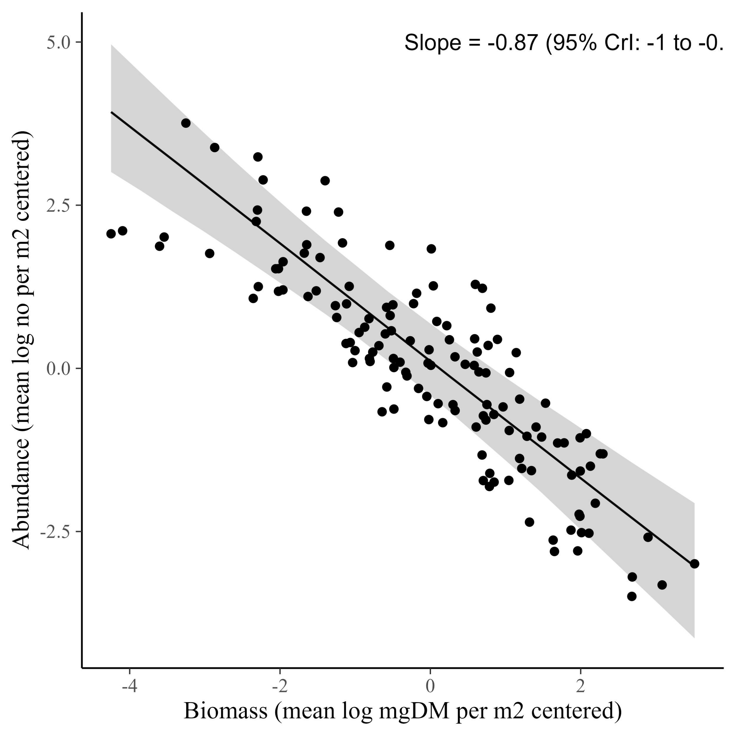
The CCSR is -0.87

Slide 17
The CCSR for the whole community is invariant across temperature and resources (data shown with GPP at it’s median)

Slide 18
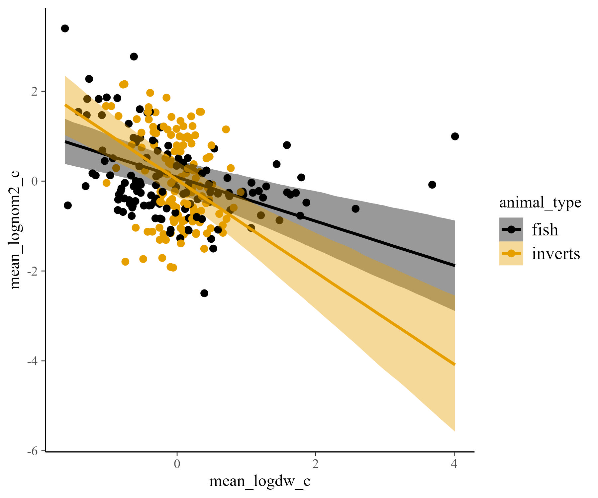
It varies by animal type, however (fish are -0.4, inverts are -0.9)

Slide 19
The CCSR becomes more negative at high temperature and high resource, especially for inverts (data shown with GPP at it’s median)

